Slide 1
Introduction to Quantum Computing: From a Layperson to a Programmer in 30 Steps
Hiu-Yung Wong
https://link.springer.com/book/10.1007/978-3-030-98339-0
https://www.amazon.com/Introduction-Quantum-Computing-Layperson-Programmer/dp/3030983382
Playlist: https://www.youtube.com/watch?v=UwRXtrrDxEk&list=PLnK6MrIqGXsJfcBdppW3CKJ858zR8P4eP&index=61
https://www.youtube.com/watch?v=l3UklDWGXT4&list=PLnK6MrIqGXsJfcBdppW3CKJ858zR8P4eP&index=29

Slide 2
Bell Inequality and Bell’s Theorem

Slide 3

https://www.linkedin.com/posts/nobelprize_nobelprize-activity-6983001491976400896-0znw?utm_source=share&utm_medium=member_desktop

Slide 4

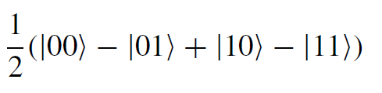
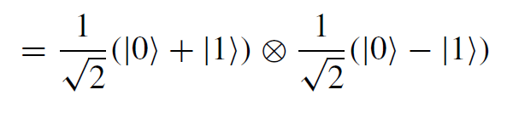
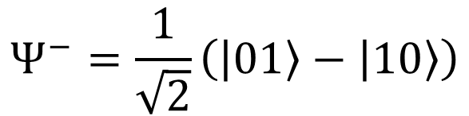
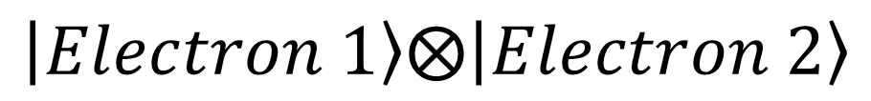
Review of Entanglement
Unentangled State
Electron 1
Electron 2
Entangled State
$$Ψ^{−}=\frac{1}{\sqrt{2}}\left(\left.\left|01\right.\right\rangle −\left.\left|10\right.\right\rangle \right)$$
$$\left.\left|Electron 1\right.\right\rangle ⨂\left.\left|Electron 2\right.\right\rangle$$

Slide 5

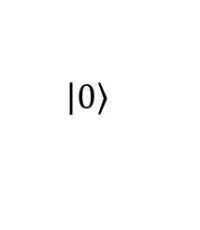




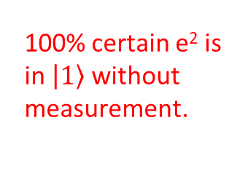
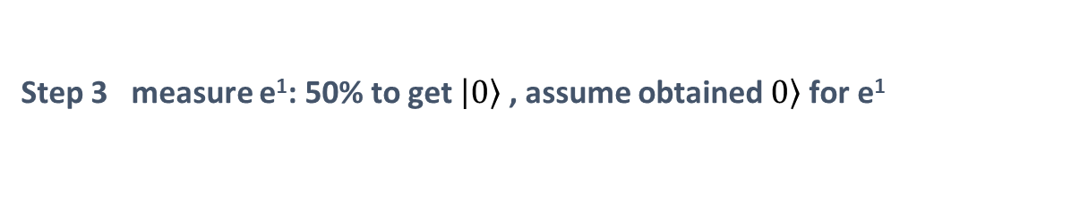
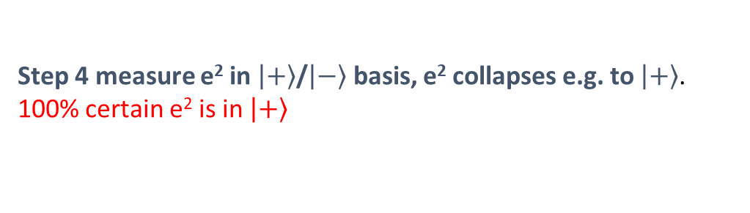

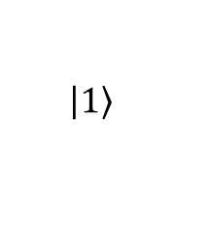
Review of EPR Paradox
Step 1
$$Ψ^{−}=\frac{1}{\sqrt{2}}\left(\left.\left|01\right.\right\rangle −\left.\left|10\right.\right\rangle \right)$$
e¹
e²
Step 2
Earth
$$Ψ^{−}=\frac{1}{\sqrt{2}}\left(\left.\left|01\right.\right\rangle −\left.\left|10\right.\right\rangle \right)$$
100 light years away
e¹
still entangled
e²
Step 3 measure e¹: 50% to get $\left.\left|0\right.\right\rangle$ , assume obtained $\left.0\right\rangle$ for e¹
collapses
100% certain e² is in $\left.\left|1\right.\right\rangle$ without measurement.
$$Ψ^{−}$$
$$\left.\left|00\right.\right\rangle$$
$$\left.\left|0\right.\right\rangle$$
Earth
100 light years away
$$\left.\left|1\right.\right\rangle$$
e¹
e²
Step 4 measure e² in $\left.\left|+\right.\right\rangle$/$\left.\left|−\right.\right\rangle$ basis, e² collapses e.g. to $\left.\left|+\right.\right\rangle$. 100% certain e² is in $\left.\left|+\right.\right\rangle$
Violates Heisenberg’s Uncertainty Principle

Slide 6
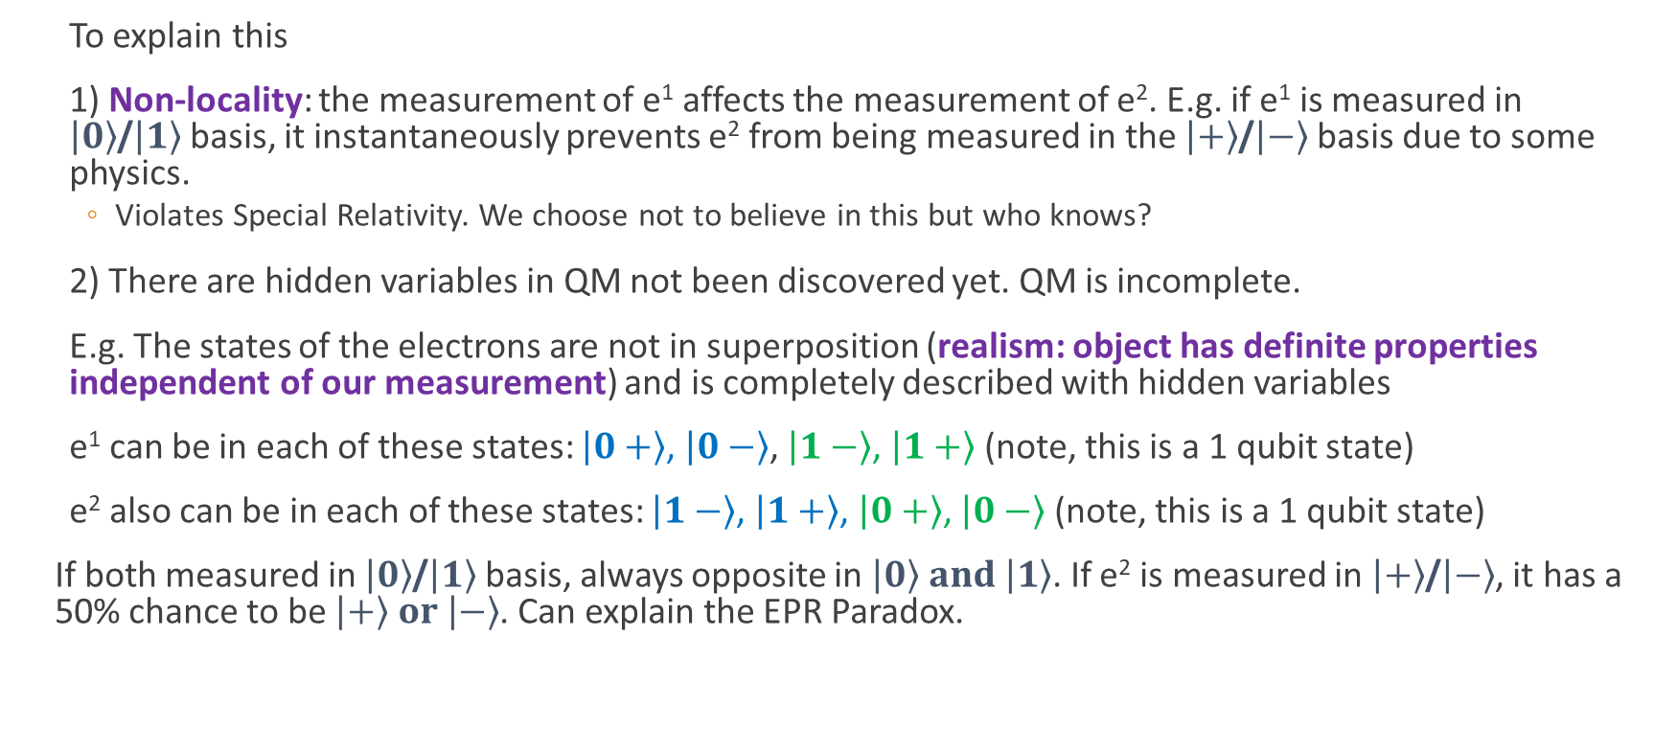
More about EPR Paradox
To explain this
1) Non-locality: the measurement of e¹ affects the measurement of e². E.g. if e¹ is measured in $\left.\left|0\right.\right\rangle$/$\left.\left|1\right.\right\rangle$ basis, it instantaneously prevents e² from being measured in the $\left.\left|+\right.\right\rangle$/$\left.\left|−\right.\right\rangle$ basis due to some physics.
Violates Special Relativity. We choose not to believe in this but who knows?
2) There are hidden variables in QM not been discovered yet. QM is incomplete.
E.g. The states of the electrons are not in superposition (realism: object has definite properties independent of our measurement) and is completely described with hidden variables
e¹ can be in each of these states: $\left.\left|0\right.+\right\rangle$, $\left.\left|0\right.−\right\rangle$, $\left.\left|1\right.−\right\rangle$, $\left.\left|1\right.+\right\rangle$ (note, this is a 1 qubit state)
e² also can be in each of these states: $\left.\left|1\right.−\right\rangle$, $\left.\left|1\right.+\right\rangle$, $\left.\left|0\right.+\right\rangle$, $\left.\left|0\right.−\right\rangle$ (note, this is a 1 qubit state)
If both measured in $\left.\left|0\right.\right\rangle$/$\left.\left|1\right.\right\rangle$ basis, always opposite in $\left.\left|0\right.\right\rangle and \left.\left|1\right.\right\rangle$. If e² is measured in $\left.\left|+\right.\right\rangle$/$\left.\left|−\right.\right\rangle$, it has a 50% chance to be $\left.\left|+\right.\right\rangle or \left.\left|−\right.\right\rangle$. Can explain the EPR Paradox.

Slide 7
Bell’s Theorem
Quantum Mechanics is incompatible with the local hidden variable theorem. That is, the local hidden variable explanation cannot explain all quantum mechanics phenomena
This is done by showing that the Bell inequality is violated
2022 Nobel Prize is awarded for their experimental works to prove Bell inequality is violated in quantum mechanics by closing many loopholes.

Slide 8
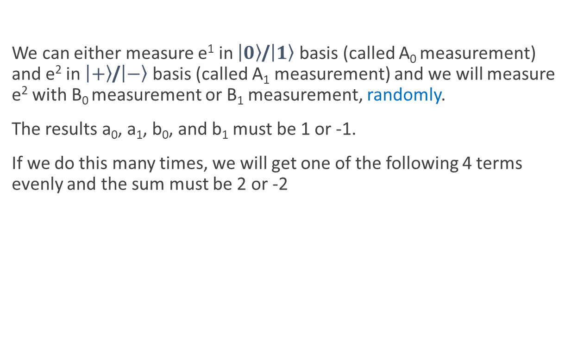

Bell Inequality (Wikipedia Example)
We can either measure e¹ in $\left.\left|0\right.\right\rangle$/$\left.\left|1\right.\right\rangle$ basis (called A₀ measurement) and e² in $\left.\left|+\right.\right\rangle$/$\left.\left|−\right.\right\rangle$ basis (called A₁ measurement) and we will measure e² with B₀ measurement or B₁ measurement, randomly.
The results a₀, a₁, b₀, and b₁ must be 1 or -1.
If we do this many times, we will get one of the following 4 terms evenly and the sum must be 2 or -2
H in z (A₀)
H in x (A₁)
So on average, Bell Inequality:
H in -(x+z)/√2 (B₀)
H in (x-z)/√2 (B₁)

Slide 9

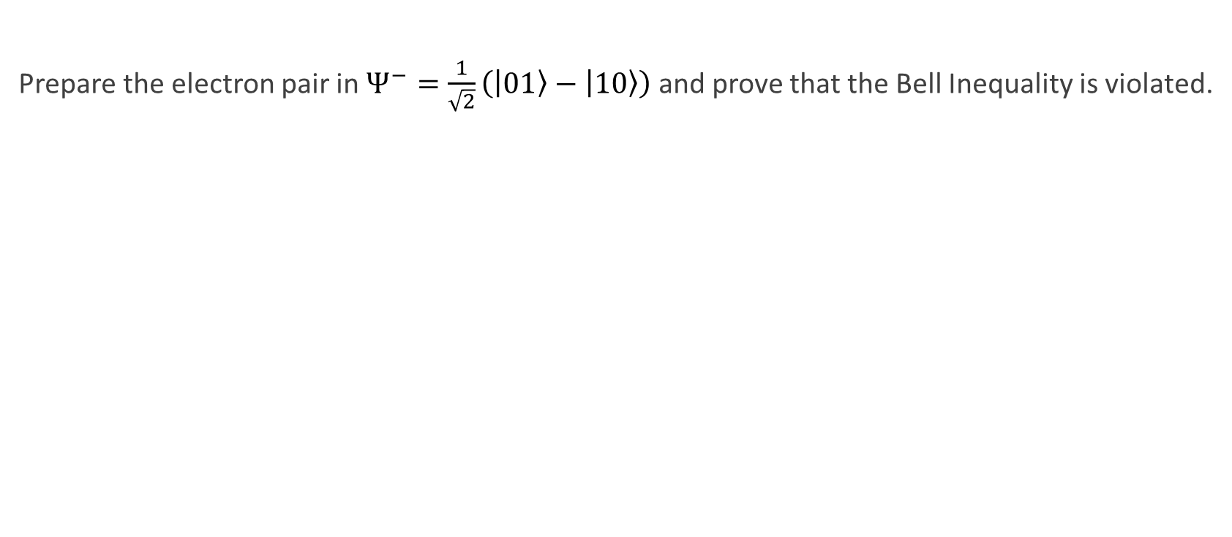
Bell Theorem (Wiki Example)
Review of Pauli and Spin matrices
Prepare the electron pair in $Ψ^{−}=\frac{1}{\sqrt{2}}\left(\left.\left|01\right.\right\rangle −\left.\left|10\right.\right\rangle \right)$ and prove that the Bell Inequality is violated.
H in z (A₀)
Wrong!
The rest is just math and we know how to do it!
H in x (A₁)
H in -(x+z)/√2 (B₀)
H in (x-z)/√2 (B₁)

Slide 10
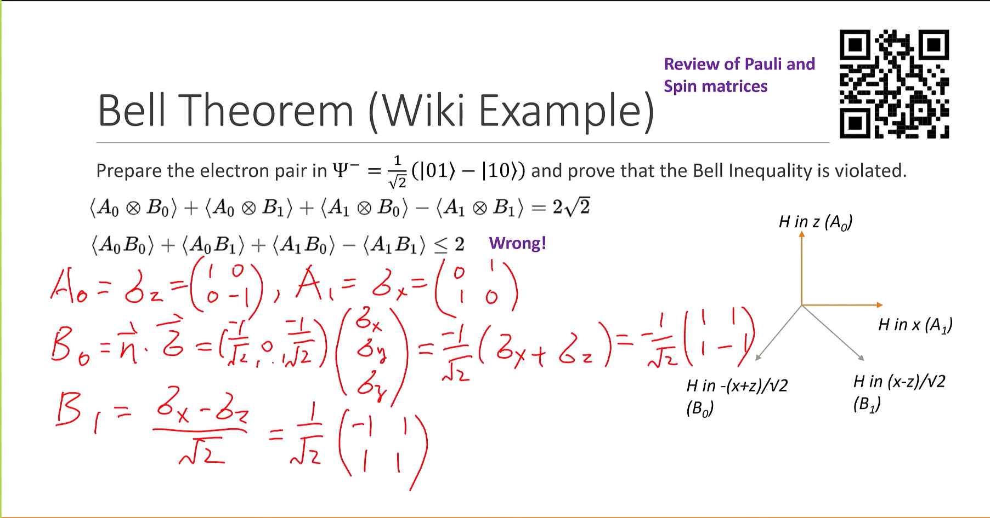

Slide 11
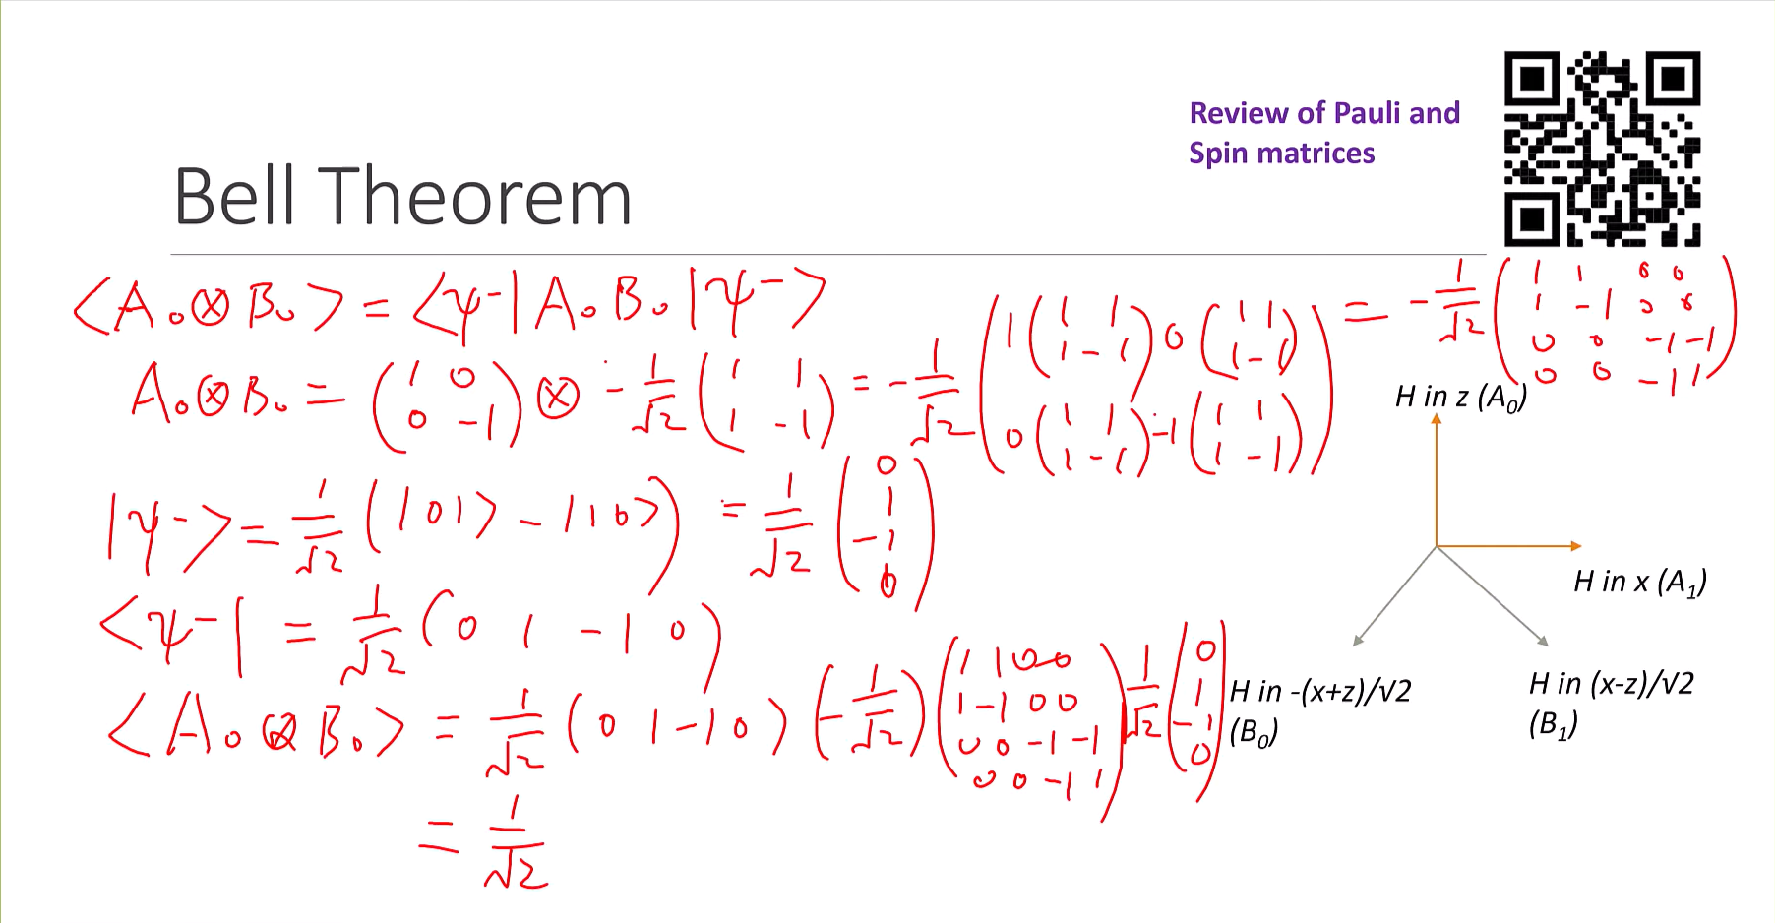

Slide 12
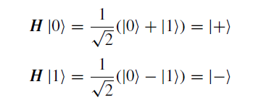

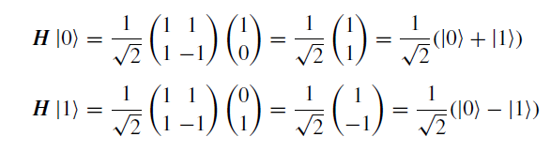
Walsh-Hadamad (Hadamad) Gate
No classical Counter-Part – create super position (previous gates only change one basis to another)

Slide 13
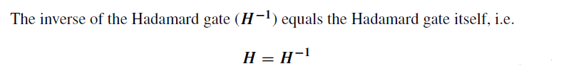

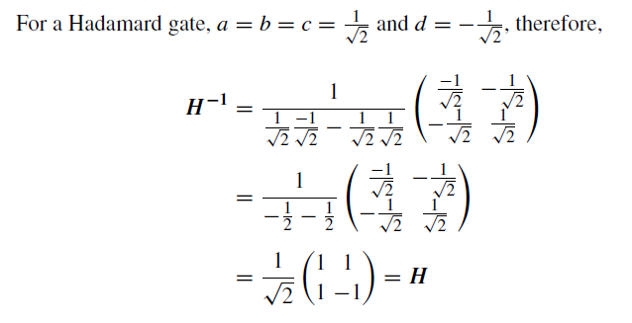
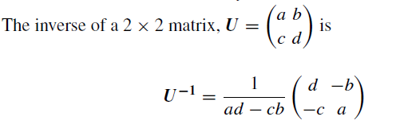
Inverse of H-Gate

Slide 14
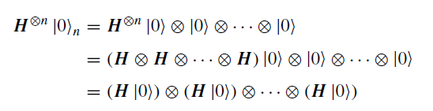
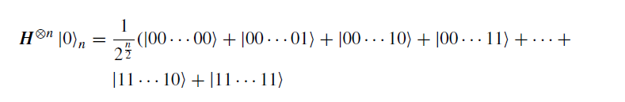
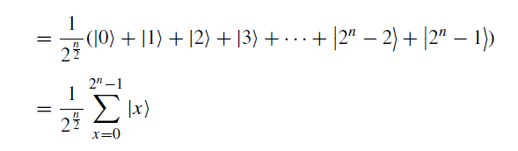
n-bit Hadamad Gate on |00…0> (n-zeros)

